Slide 1
HITECH HIPAA Pointers Six Takeaways from the New HIPAA Regulations
Health TechNet Meeting
Friday, March 15, 2013
Cindy Hutto, Esq.

Slide 2
Six Takeaways
Business Associates
Contractual Requirements
Marketing and Sale of PHI
Individual Rights
Breach
Penalties and Enforcement
2

Slide 3
A Long Time Coming…
Health Information Technology for Economic and Clinical Health Act ("HITECH Act") – February 17, 2009
Proposed Regulations – July 14, 2010
Final "Omnibus" HIPAA Regulations – January 25, 2013
Effective Date: March 26, 2013
Compliance Date: September 23, 2013
Copy of Final Regulations: http://bit.ly/XMxrWe
3

Slide 4
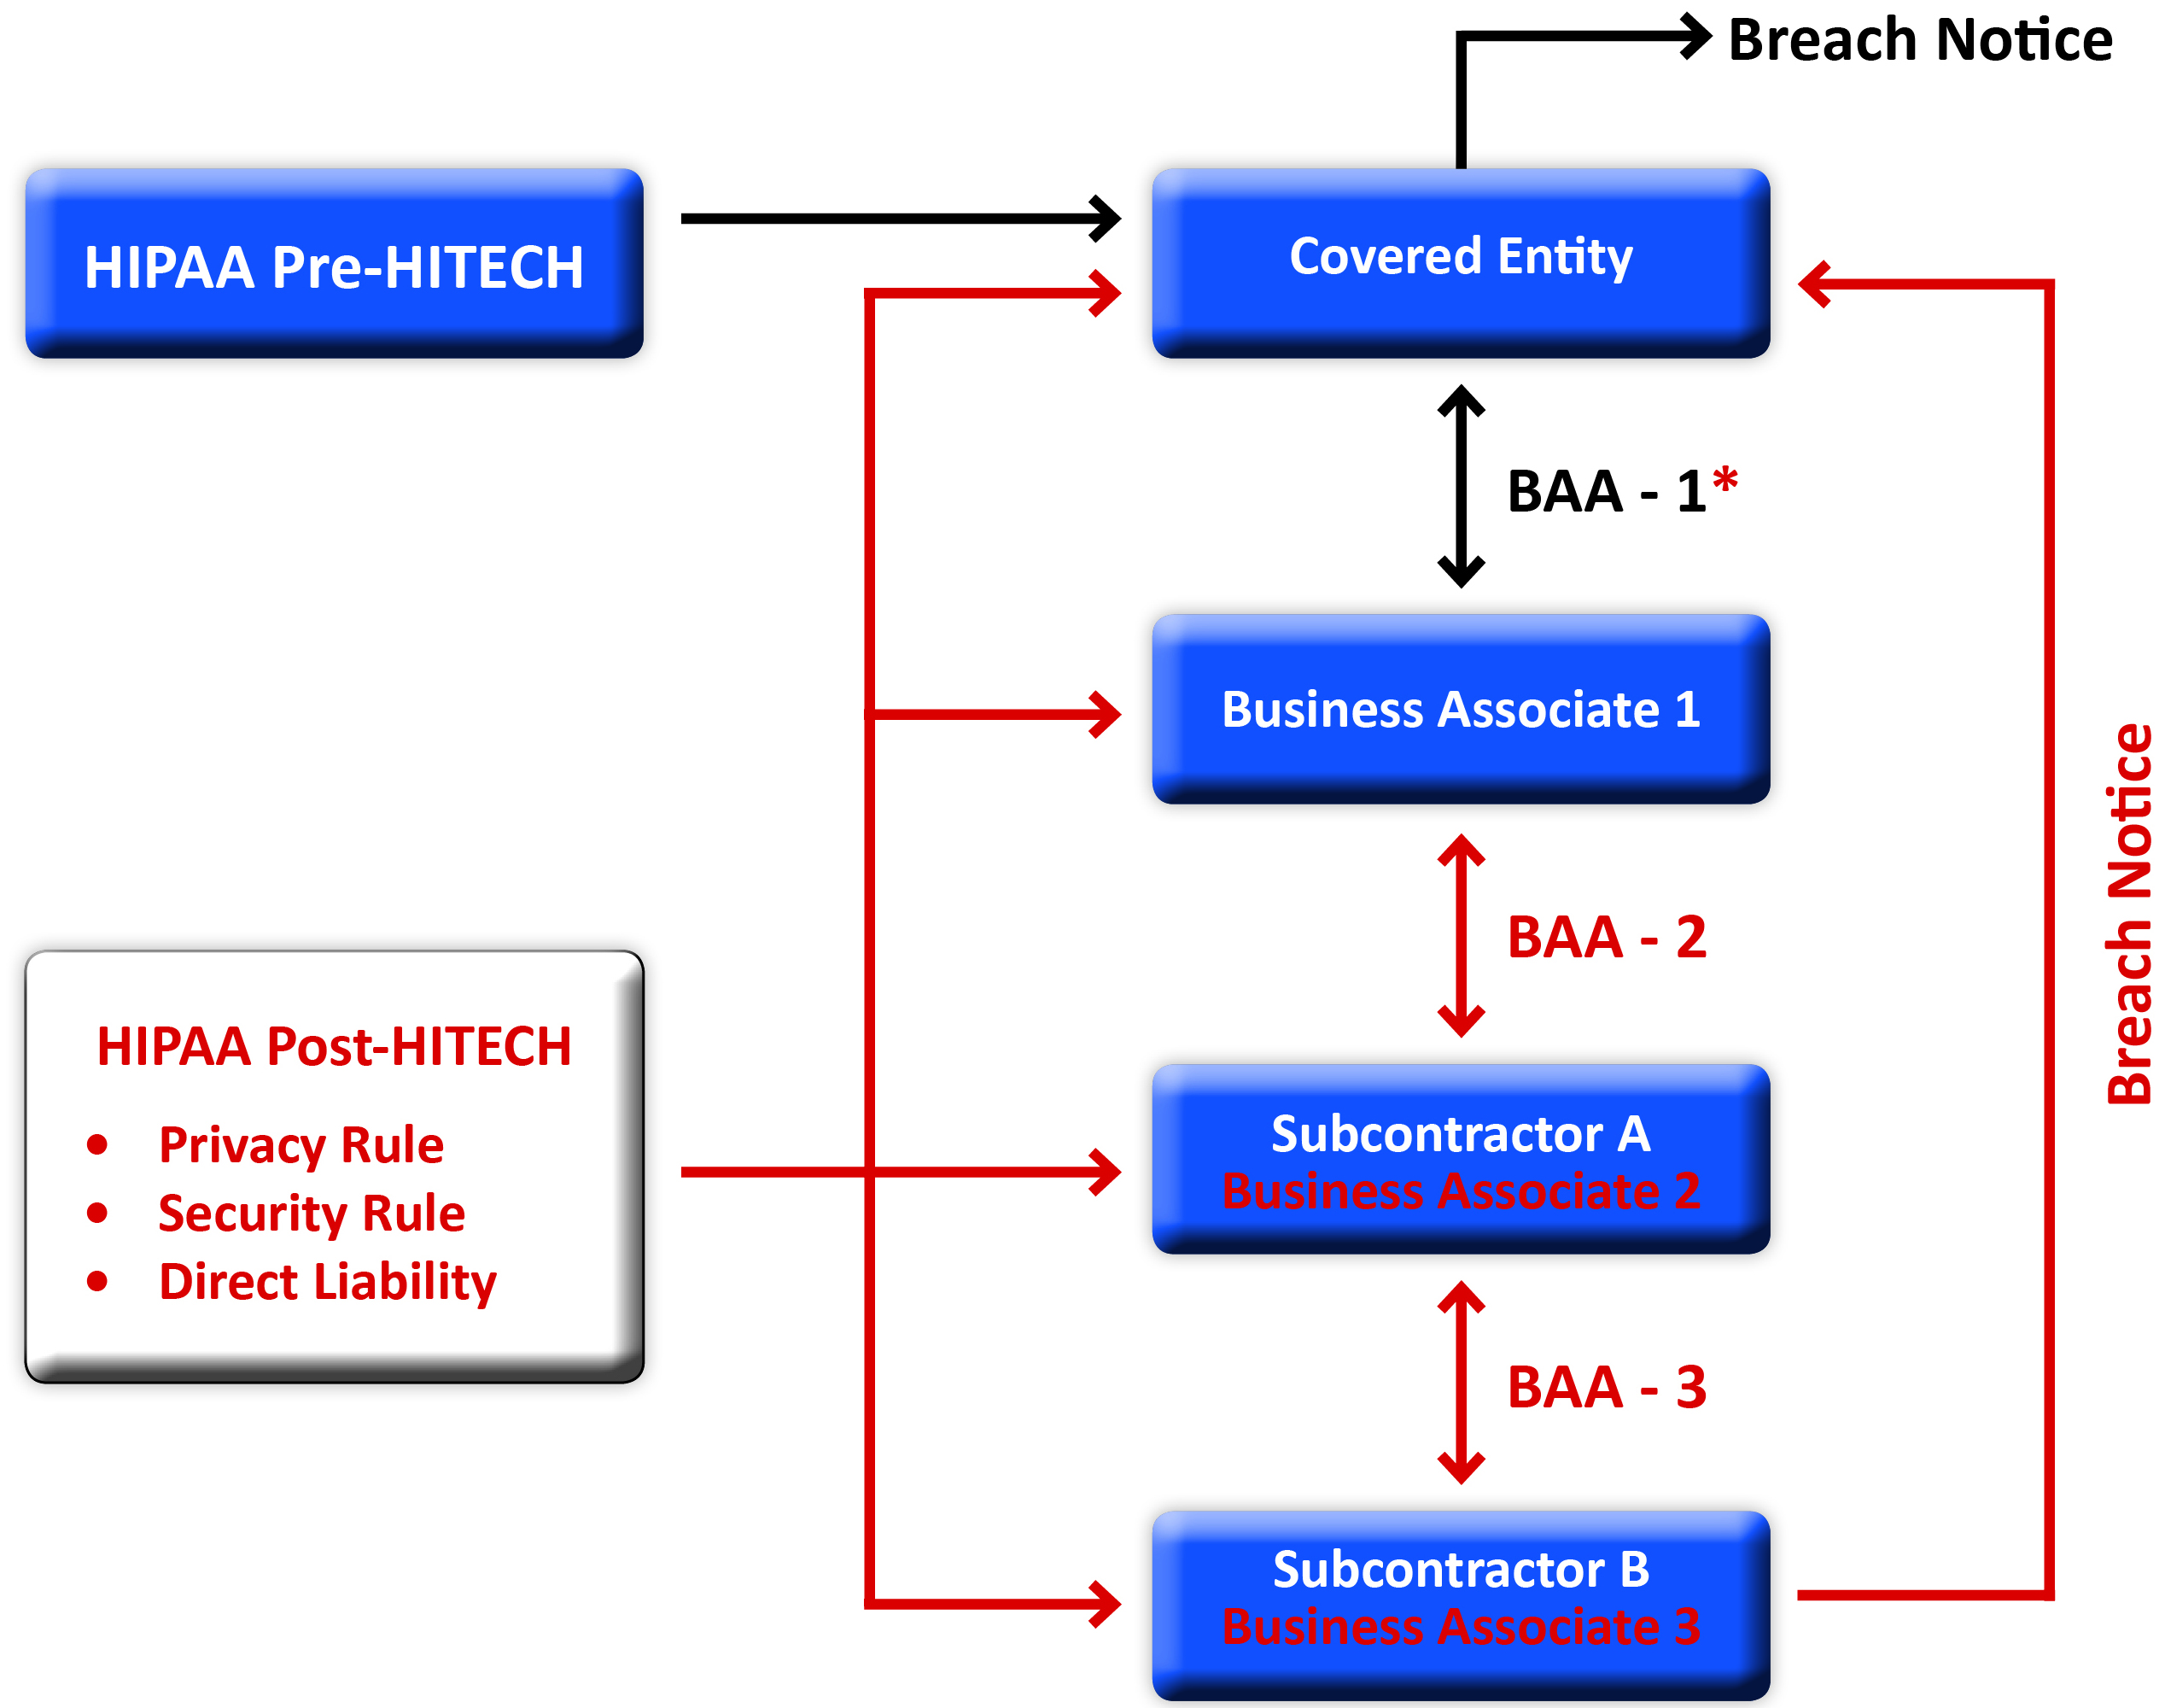
Business Associates
4

Slide 5
Action Items
Inventory Relationships
Clarify Status
The "new" Business Associate
The "inadvertent" Business Associate
Business Associate Compliance Steps
Substantive Requirements
Privacy Rule
Security Rule (including Risk Assessment)
Administrative Requirements
Policies and Procedures
Documentation
Training
5

Slide 6
Contractual Requirements
6

Slide 7
Action Items
BAA Audit
Update Existing BAA's
Develop/execute Sub-BAA's
Pre-HITECH
HIPAA + HITECH
Breach
Contents of master BAA
Discretionary Changes/Provisions
Deadlines/Transition Period
January 25, 2013
March 26, 2013
September 23, 2013
September 22, 2014
7

Slide 8
Financial Arrangements Involving PHI
Marketing
A communication about a product or service that encourages recipients of the communication to purchase or use the product or service.
Marketing activities require patient authorization, unless an exception applies.
Limited exception for treatment and health care operations communications that do not involve financial remuneration.
Sale of PHI
The disclosure of PHI by a covered entity or business associate where the CE or BA receives remuneration in exchange for the PHI.
Sale of PHI requires patient authorization, unless an exception applies.
8

Slide 9
Action Items
Evaluate existing financial arrangements to determine whether you are engaging in marketing or sale of PHI, and whether any exceptions apply.
Revise HIPAA authorization forms.
Update Notice of Privacy Practices (if applicable).
Update HIPAA Policies and Procedures.
9

Slide 10
Individual Rights
Right to Request Restrictions
Covered entities must comply with a patient's request to restrict disclosures of PHI to a health plan if: (1) the disclosure is for purposes of payment or healthcare operations; and (2) the PHI relates to an item or service for which the CE has been paid in full.
Limited exception for disclosures "required by law."
Patient Access to Electronic PHI
Covered entities must provide patients with access to electronic PHI in the electronic form and format requested by the patient.
Covered entity must provide access within 30 days of patient's request.
Covered entity may charge reasonable, cost- based fees for labor and supplies.
10

Slide 11
Action Items
Update Notice of Privacy Practices to reflect new patient restriction and PHI access rights (if applicable).
Update HIPAA Policies and Procedures.
Train workforce members responsible for responding to patient access and restriction requests.
11

Slide 12
Breach
New Breach Threshold/Burden Shifting
Threshold: Presumption of Breach by Covered Entity or Business Associate
Burden Shifting: Burden of Proof on Covered Entity or Business Associate
12

Slide 13
Breach (Cont'd)
Multi-Factor Breach Analysis
Minimum Factors for Risk Assessment:
Nature/Extent of PHI Involved
Unauthorized Person who used/received PHI
PHI actually viewed/acquired
Extent of Mitigation
Action Steps
Update Breach Policy and Procedures
Provide Training
Business Associate Agreements
13

Slide 14
Enforcement
Violation – State of Mind | Penalty Range per Violation | Maximum amount for all such violations of an identical provision in a calendar year
Did Not Know | $100 – $50,000 | $1,500,000
Reasonable Cause | $1,000 – $50,000 | $1,500,000
Willful Neglect – Corrected | $10,000 – $50,000 | $1,500,000
Willful Neglect – Not Corrected | $50,000 | $1,500,000
14

Slide 15
Enforcement (Cont'd)
Covered Entity Liability for Business Associate Agents
Covered Entity Liable for CMP of Business Associate when:
Acting as agent of Covered Entity
Analyzed under Federal Common Law of agency
Business Associate liable for CMPs of subcontractors under same analysis
15

Slide 16
Questions?
David Main
202.545.2959
david.main@nelsonmullins.com
Cindy Hutto
843.720.4307
cindy.hutto@nelsonmullins.com
Eli Poliakoff
843.534.4122
eli.poliakoff@nelsonmullins.com
Freddie Zufelt
919.329.3819
freddie.zufelt@nelsonmullins.com
16

